Slide 1

Group 16 Presents

Slide 2
The Team
Front End
John Pacheco
Orlando Rodriguez
Back End
Marcelino Pozo
James Moore
Database
Austin Stafford
Project Manager
Julian Espinoza

Slide 3
The Product

Slide 4
The Concept
Our group set out to make a program that would be feasible to make in the time that was allotted to us. We also wanted to make something that would be fun to make and serve some kind of actual use. To that end, we ended up settling on making a movie list app called “Movie Knight.”
Our target audience is anyone who likes movies, though the pun in the name makes it more targeted towards UCF students.

Slide 5
Objectives
Add and remove movies from your own personal list
Review movies on your list
Mobile Friendly
Multiple themes and colorblind accessibility

Slide 6
Development

Slide 7
The Basics
Our group utilized a MERN stack in the reaction of our project. Development happened over the course of four weeks with about two of them being used to learn and get used to the new framework. While it was tough, I think our group was able to create and provide an exceptional product.
Our group primarily communicated over Discord with multiple in-person meetups happening over the course of the project. During these meetings, we would discuss what needed to get done and work together as a group to achieve our set goals.
In terms of management methodology, we didn’t use any particular model. Instead, we created an initial design document that detailed everything we wanted to get done and worked as a team to get it all done. We had a plan and we stuck to the plan.

Slide 8
The Tools
Front End
Figma
Adobe Photoshop
Back End
Postman
Database
Mongodb/Atlas

Slide 9
The Tools
Group
Discord
GitHub
Visual Studio Code

Slide 10
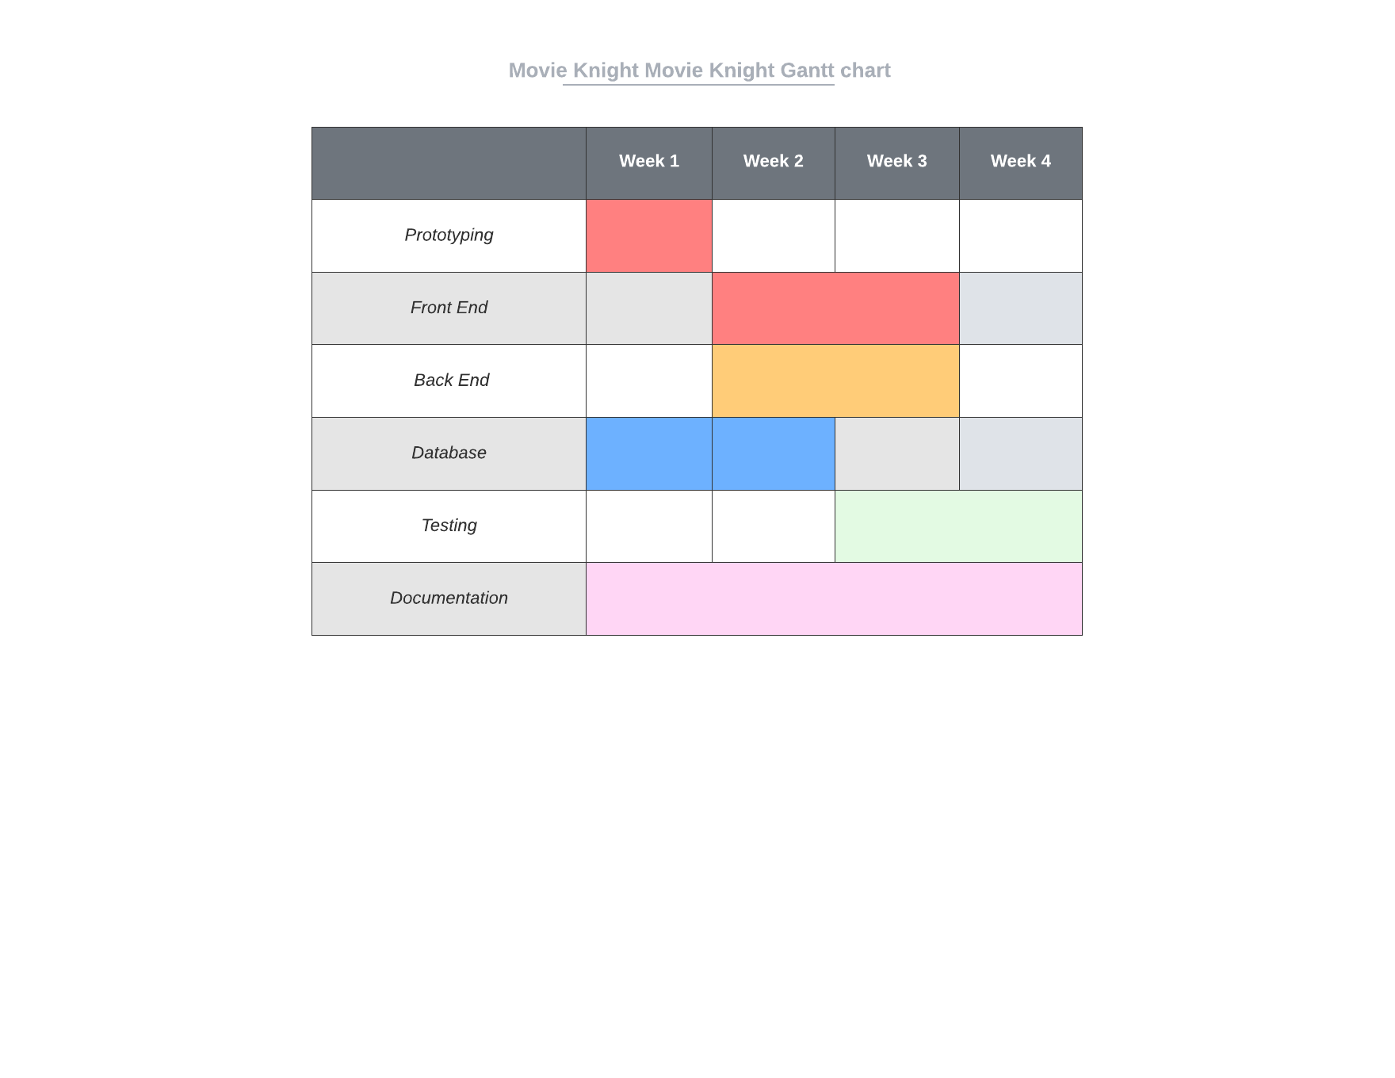
Gantt Chart

Slide 11
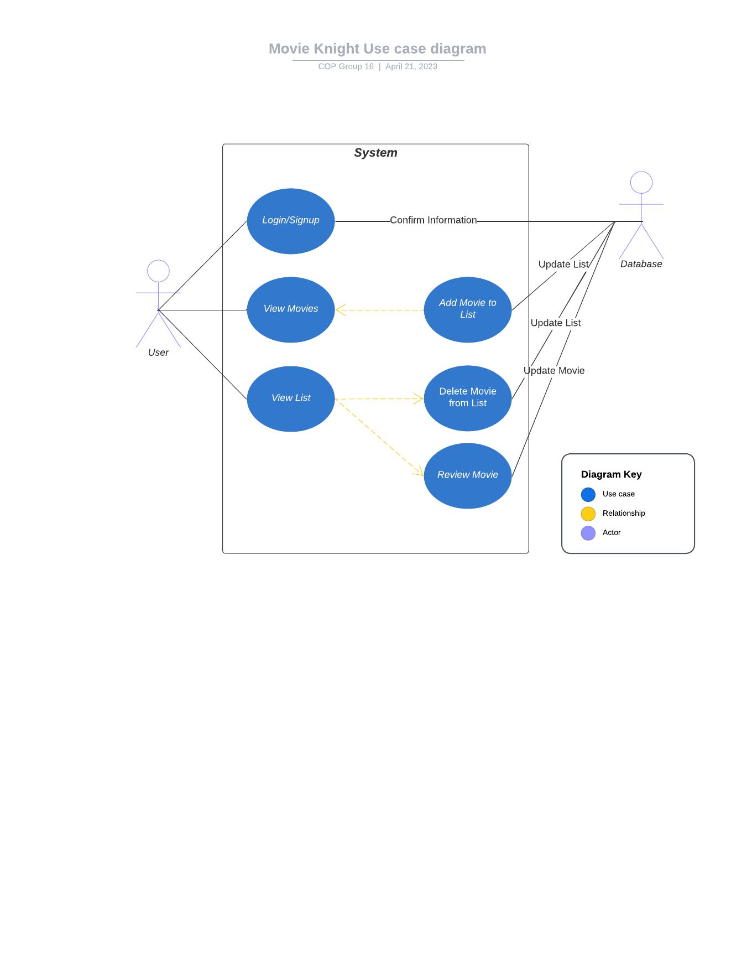
Use-Case Diagram

Slide 12
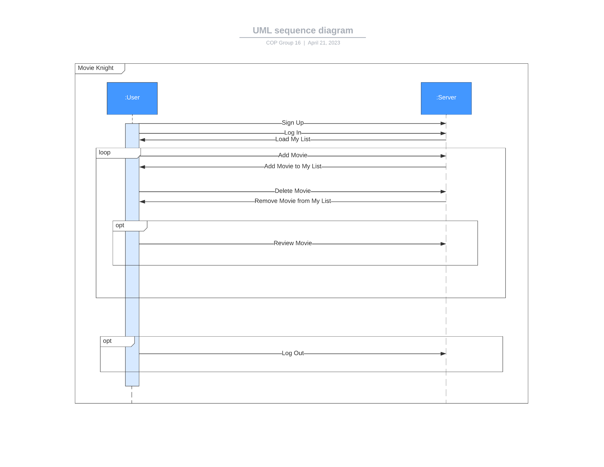
UML Sequence Diagram

Slide 13
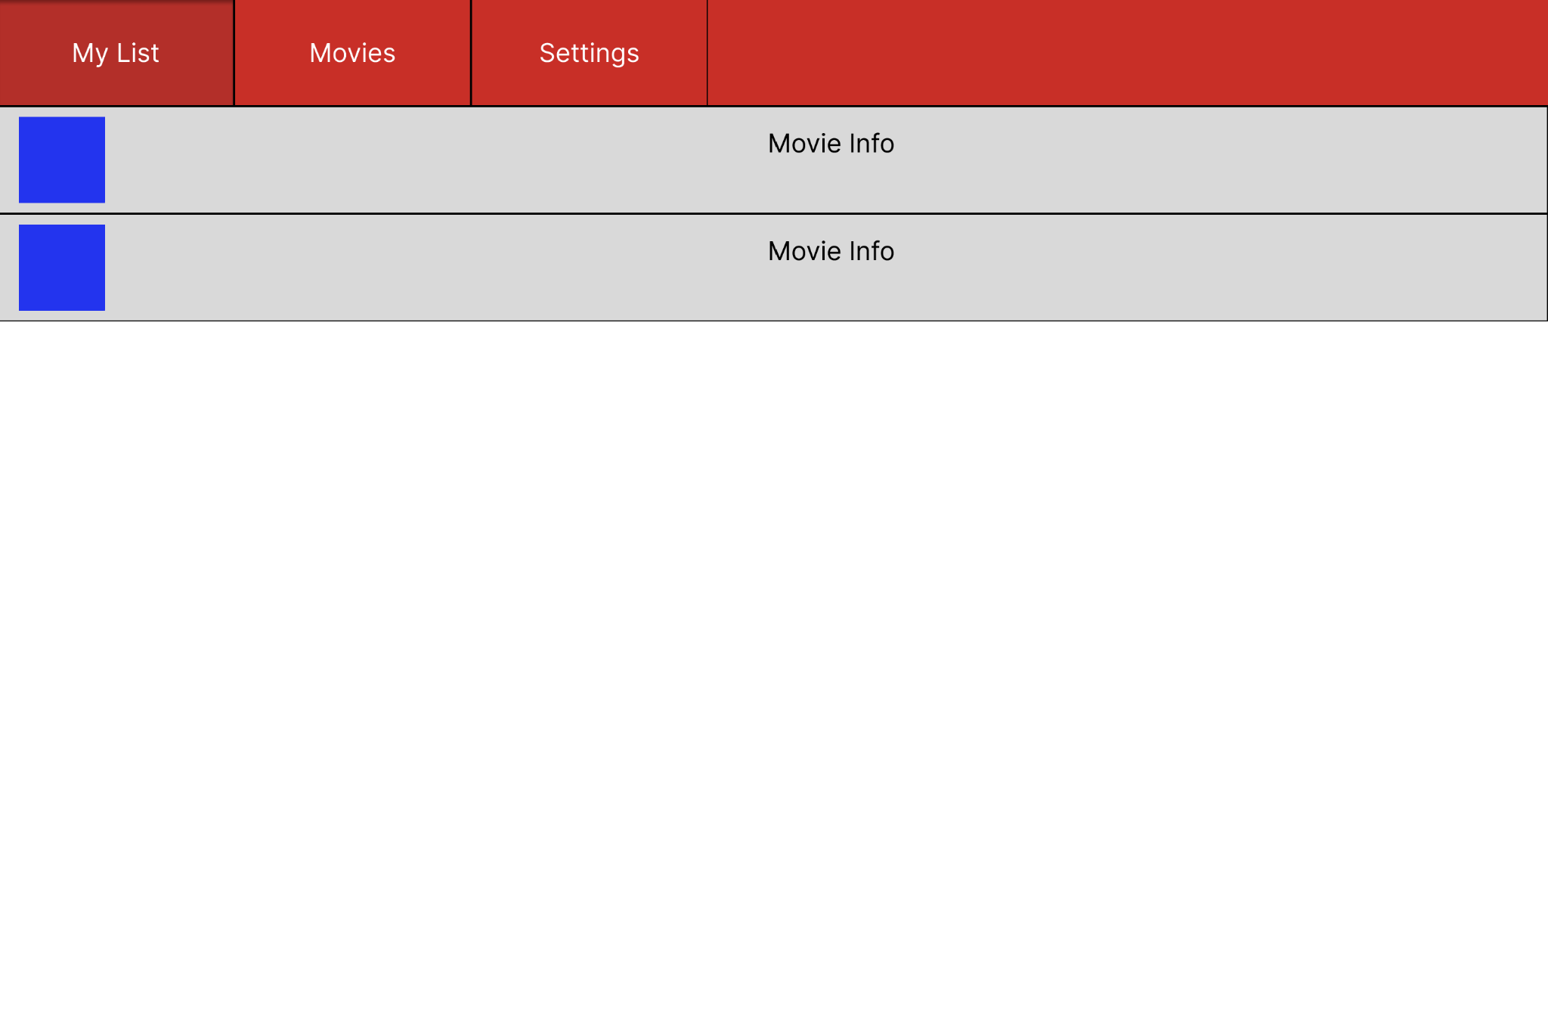
Prototype

Slide 14
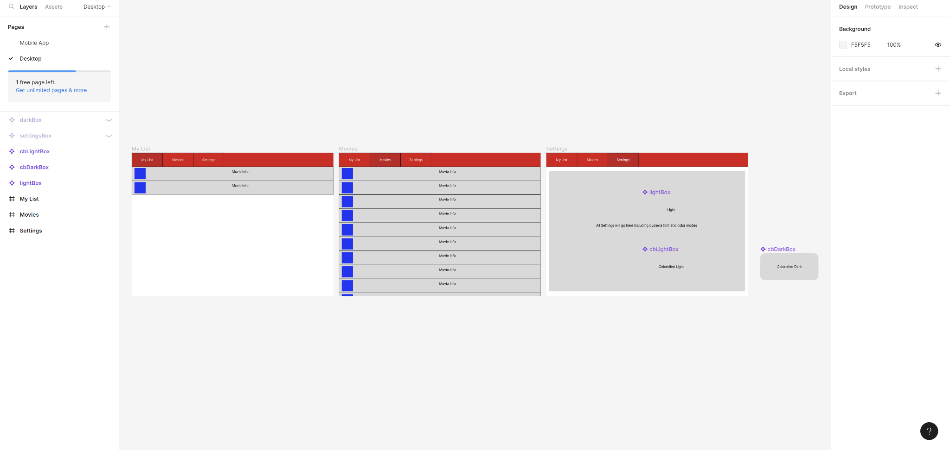
Prototype

Slide 15
Discoveries

Slide 16
The Good
Our group was able to get up and running fairly quickly and had a full design plan/document done by the first meeting
If someone was having a problem understanding something, another group member would assist them in figuring it out. When working in a new system in such a short time, teamwork makes the dream work.
Communication, for the most part, was fairly okay and the members were able to be reached easily.

Slide 17
The Bad
Feature creep was a legitimate concern. Especially with an ever shifting deadline, we weren’t sure if we were able to implement everything that we wanted to and even considered cutting the feature to review movies entirely at one point.
The massive learning curve to MERN in such a short time disoriented the team and led to a large unproductive period while everyone scrambled to learn. Despite the constant sharing of resources, it still took a considerable amount of time to get it down.

Slide 18
Questions?

